Slide 1
Using Bayesian Multilevel Models to Analyze Coregulation in Dyadic Physiological Data
Niall Bolger & Katherine Zee
Society for Ambulatory Assessment
June 15, 2017

Slide 2
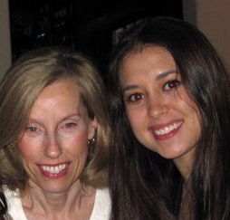

Selcuk et al. (2012)
Coan et al. (2006)
Moderate pain High pain
Eisenberger et al. (2011)

Slide 3
Coregulation
Time
Butler (2011); Butler & Randall (2013); Sbarra & Hazan (2008)

Slide 4
Coregulation
Synchrony
Time
Time

Slide 5
Hypothesis
Social Support
Time

Slide 6
Hypothesis
Social Support
Time

Slide 7
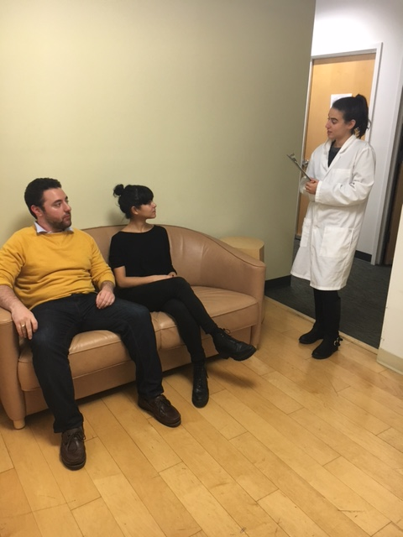
Method
N = 78 romantic partner dyads
Mean Relationship Length = 3.9 years (SD = 3.1)
Mean Age = 27.4 (SD = 6.3)
Notes:
Age range is 18-60
Relationships up to 21 yrs in length

Slide 8
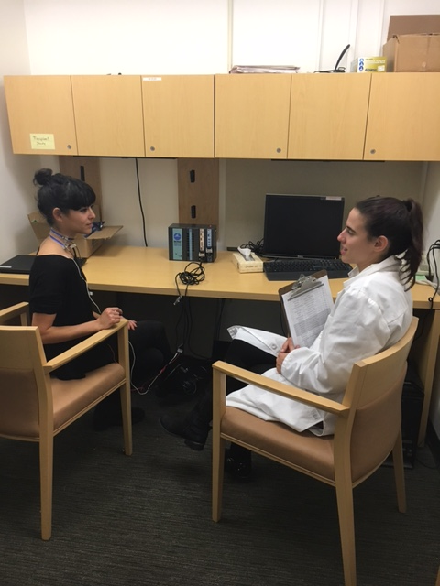
Method
N = 78 romantic partner dyads
Mean Relationship Length = 3.9 years (SD = 3.1)
Mean Age = 27.4 (SD = 6.3)
Notes:
Age range is 18-60
Relationships up to 21 yrs in length

Slide 9
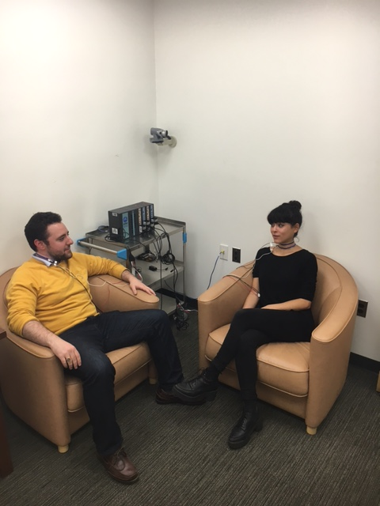
Method
N = 78 romantic partner dyads
Mean Relationship Length = 3.9 years (SD = 3.1)
Mean Age = 27.4 (SD = 6.3)
Notes:
Age range is 18-60
Relationships up to 21 yrs in length

Slide 10
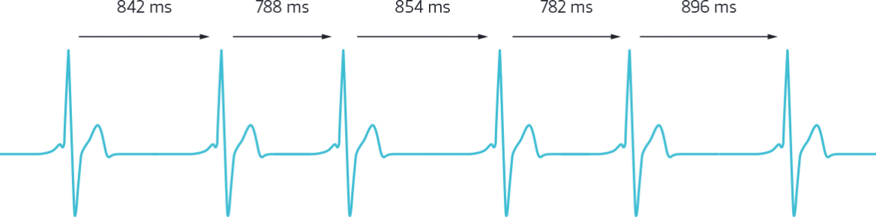
Heart Rate Variability (HRV)
78 dyads x 2 partners/dyad x 10 observations =
1560 observations/interaction

Slide 12
Analysis Strategy
Two-intercept model to account for dyadic structure (Bolger & Laurenceau)
Bayesian Multilevel Modeling
Weak normal prior

Slide 13
Advantages of Bayesian MLM for Intensive Longitudinal Data
Handles multiple random effects more easily (and provides credibility intervals)
Allows specification of autocorrelated errors
Easily implemented in R with brms package (Bürkner)
Suitable for multilevel mediation analyses with the bmlm package (Vuorre, 2016)

Slide 14
Physiological Coregulation over Time - Providers
Beginning
Middle
End
Recipient Heart Rate Variability
Lagged Provider Heart Rate Variability
(within-person baseline centered)
Notes:
For female providers only

Slide 15
Physiological Coregulation over Time - Providers
Beginning
Middle
End
Recipient Heart Rate Variability
Lagged Provider Heart Rate Variability
(within-person baseline centered)
Notes:
For female providers only

Slide 16
Physiological Coregulation over Time - Providers
Beginning
Middle
End
Recipient Heart Rate Variability
Lagged Provider Heart Rate Variability
(within-person baseline centered)
Notes:
For female providers only

Slide 17
Physiological Coregulation over Time - Providers
Beginning
Middle
End
Recipient Heart Rate Variability
Lagged Provider Heart Rate Variability
(within-person baseline centered)
Notes:
For female providers only

Slide 18
Physiological Coregulation over Time - Recipients
Beginning
Middle
End
Provider Heart Rate Variability
Lagged Recipient Heart Rate Variability
(within-person baseline centered)
Notes:
For female providers only

Slide 19
Physiological Coregulation over Time - Recipients
Beginning
Middle
End
Provider Heart Rate Variability
Lagged Recipient Heart Rate Variability
(within-person baseline centered)
Notes:
For female providers only

Slide 20
Physiological Coregulation over Time - Recipients
Beginning
Middle
End
Provider Heart Rate Variability
Lagged Recipient Heart Rate Variability
(within-person baseline centered)
Notes:
For female providers only

Slide 21
Physiological Coregulation over Time - Recipients
Beginning
Middle
End
Provider Heart Rate Variability
Lagged Recipient Heart Rate Variability
(within-person baseline centered)
Notes:
For female providers only

Slide 22
Gender Differences in Support
Men and women equally skilled, but women more responsive
Women’s emotional distress impairs men’s support provision, but not vice versa
Neff & Karney (2005); Bodenmann et al. (2015); Randall & Bodenmann (2017)

Slide 23
Interim Summary
Time
Notes:
Can one predict the other (concurrently?): YES, WHEN FEMALES PROVIDE/MALES RECEIVE THERE IS CONCURRENT SYNCHRONY EMERGING OVER TIME (F → M)
NO SYNCHRONY DURING GOAL DISCUSSION
Just look at one dyad at a time, show a correlation (“synchrony”)
See added variable plot (see Fox book). Might have to do ordinary least squares regressions? Slope will be similar to slope from the model (points have been adjusted→ predicted points with controlling for education)]

Slide 24
Interim Summary
Time
Notes:
Can one predict the other (concurrently?): YES, WHEN FEMALES PROVIDE/MALES RECEIVE THERE IS CONCURRENT SYNCHRONY EMERGING OVER TIME (F → M)
NO SYNCHRONY DURING GOAL DISCUSSION
Just look at one dyad at a time, show a correlation (“synchrony”)
See added variable plot (see Fox book). Might have to do ordinary least squares regressions? Slope will be similar to slope from the model (points have been adjusted→ predicted points with controlling for education)]

Slide 25
Alternative Explanations
Synchrony?

Slide 26
Alternative Explanations
Synchrony?
Dyadic interactions?

Slide 27
Alternative Explanations
Synchrony?
Dyadic interactions?
Within-person process?

Slide 28
Alternative Explanations
Synchrony?
Dyadic interactions?
Within-person process?
Implications?

Slide 29
Objective Coding Procedure
30-sec segments
ICCs > .70
30 videos coded thus far = 300 observations

Slide 30
Affective Coregulation over Time
Beginning
Middle
End
Middle
End
Recipient Positive Affect
Lagged Provider Positive Affect
(within-person centered)

Slide 31
Affective Coregulation over Time
Beginning
Middle
End
Middle
End
Recipient Positive Affect
Lagged Provider Positive Affect
(within-person centered)

Slide 32
Affective Coregulation over Time
Beginning
Middle
End
Middle
End
Recipient Positive Affect
Lagged Provider Positive Affect
(within-person centered)

Slide 33
Affective Coregulation over Time
Beginning
Middle
End
Middle
End
Recipient Positive Affect
Lagged Provider Positive Affect
(within-person centered)

Slide 34
Summary
Social support → coregulation
Not due to:
Synchrony
Interpersonal interactions in general
Within-person processes

Slide 35
Future Directions
Explore heterogeneity
Dynamical systems modeling
Recipient HRV
Provider
Recipient
Lagged Provider HRV
Butler (2011)

Slide 36



Thank you!
Symposium Chair: Michael Russell
Abdiel Flores
Matti Vuorre
Research Assistants:
Carina Brown, Jessica Paek, Sophia Golden, Jessica Gingrich,
Kate Puglia, Jordan Cline, Lauren Cohen, Alexander Fulmer,
Sarah Goetzke, Lana Khamash, Shelagh Mahbubani, Max Mikelic,
Courtney Peters, Sam Pitasky, and Saya Weissman

Slide 39
Control Discussion

